Slide 1
AirDat32A.xla
(US Standard Day Atmosphere)
(Excel Add_In implementation)
Utility by
Kelan Sisk

Slide 2
Disclaimer
Redistribution and use of the AirDat32A Excel Add_In is permitted provided that the following condition is met:
Redistributions must reproduce this condition and the following disclaimer in the documentation and/or other materials provided with the distribution.
THIS SOFTWARE IS PROVIDED “AS IS” AND ANY EXPRESS OR IMPLIED WARRANTIES, INCLUDING BUT NOT LIMITED TO, THE IMPLIED WARRANTIES OF MERCHANTABILITY AND FITNESS FOR A PARTICULAR PURPOSE ARE DISCLAIMED. IN NO EVENT SHALL THE AUTHOR BE LIABLE FOR ANY DIRECT, INDIRECT, INCIDENTAL, SPECIAL, EXEMPLARY, OR CONSEQUENTIAL DAMAGES (INCLUDING BUT NOT LIMITED TO, PROCUREMENT OF SUBSTITUE GOODS OR SERVICES, LOSS OF USE, DATA, OR PROFITS, OR BUISINESS INTERRUPTION) HOWEVER CAUSED AND ON ANY THEORY OF LIABILITY, WHETHER IN CONTRACT, STRICT LIABILITY, OR TORT (INCLUDING NEGLIGENCE OR OTHERWISE) ARISING IN ANY WAY OUT OF THE USE OF THIS SOFTWARE, EVEN IF ADVISED OF THE POSSIBILITY OF SUCH DAMAGE.

Slide 3
What is an Excel Add-In?
An Add-In is a compiled Excel file
It is installed via the menu Tools/Add-Ins… option
Once installed it is read in at the beginning of EVERY Excel session (whether you want/need it or not).
It will continue to be part of your Excel sessions until it is deselected via the menu Tools/Add-Ins… option
Rather than the normal “.xls” file extension it has the extension of “.xla”
All macros in the Add-In are available to every Excel file you open

Slide 4
Add-Ins: What are the Pros?
The macro code is available to each and every file
  No copying of macro code is required to gain access
Macro code is not duplicated in each file
  File sizes will be smaller than if the macro code were copied to multiple files.
  There is only one source of the macro to correct if a problem is found. Only the Add-In would need updating and then all files will gain access to the update as soon as they are opened.
  User’s don’t have to worry whether the macro code is up to date. The latest instance will always be used.

Slide 5
Add-Ins: What are the Cons?
Most people are not familiar with Add-Ins
File sharing requires coordination
  A common repository for the Add-In needs to be set up so all users in a group have access to it.
  All users need to assign the Add-In in a consistent manner to avoid unresolved references (links) from occurring.
  Sharing files with those who have not assigned the Add-In in a consistent manner requires some work to resolve
  Sharing files with those who will never bother with the Add-In needs to be addressed

Slide 6
When Would You Want to Use an
Add-In rather than macros?
Use an Add-In if you have macro functions or sub-routines that are...
  General in nature
  Used frequently
Routines of this sort are prime candidates for a function library
An Add-In is no more than a function library

Slide 7
What Do You Get w/ AirDat32A?
You get the “AirData” function
  =AirData(input string 1, input value 1, input string 2, input value 2, output string)
  where,
  input string 1 = PRIMARY input name
  input value 1 = PRIMARY input value
  input string 2 = SECONDARY input name
  input value 2 = SECONDARY input value
  output string = output name

Slide 8
What Do You Get w/ AirDat32A?
You also get a new menu item to assist you in remembering how to use the AirData function.
The new menu item, “AirData”
Originally this menu item was “Pax_Lib” for reasons beyond the scope of this documentation. However, the author has not made the time to correct the screen captured graphics that follow. For the remainder of this documentation “Pax_Lib” will be used to match the graphics.

Slide 9
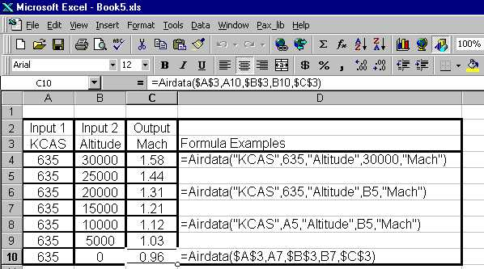
AirData Function - Example
Note the addition of a new Menu item from installing the AirDat32A Add_In.
(Current release displays as “AirData” menu item
Initial Formula
(Cell C4 and D4)
Input String 1 : KCAS
Input Value 1 : 635
Input String 2 : Altitude
Input Value 2 : 30000
Output String : Mach
Valid input/output strings will be discussed later in this presentation.

Slide 10
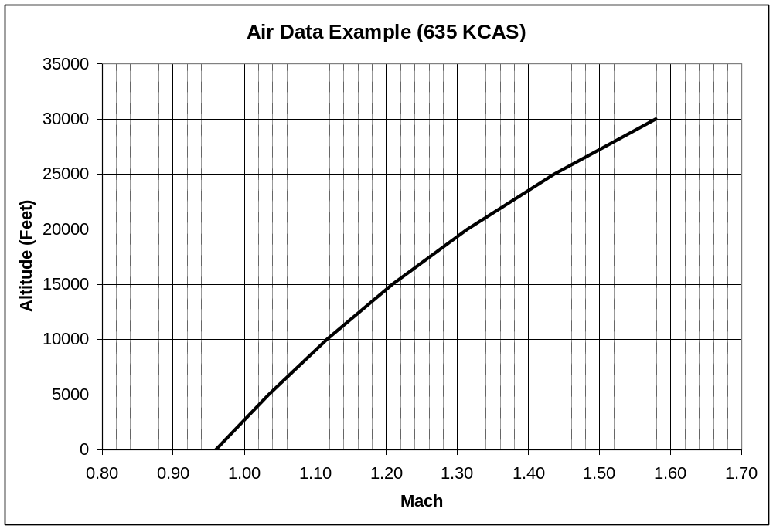
AirData Function - Example
Here’s the previous data plotted out.

Slide 11
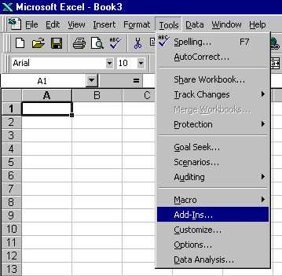
Assigning an Add-In
1) Save the AirDat32A.xla file into a directory accessible by the target user group
2) Open Excel
3) Open a file (can be a new, empty, or pre-existing file)
4) At the Menu bar select
  Tools / Add-Ins...

Slide 12
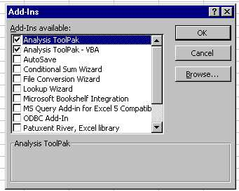
Assigning an Add-In
Any currently assigned Add-Ins will be checked
Browse to find the AirDat32A.xla file
If you have never assigned Pax_Lib as an Add-In before, you will not see this entry.
AirDat32A will show up in the Add-In list as;
“AirDat32A, Excel library”.

Slide 13
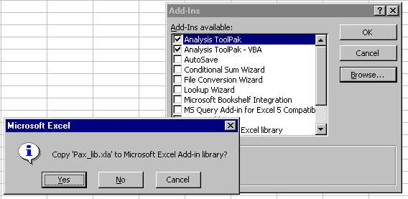
Assigning an Add-In
*** Important *** When prompted to
Copy ‘AirDat32A.xla’ to Microsoft Excel Add-in library?
Select NO
NO

Slide 14
Assigning an Add-In
Why answer NO to the question of copying the xla to the Excel library?
  Answering YES, will make a copy of AirDat32A.xla and put it in your local hard drive but in a location that is dependant on how Excel was installed on your local machine.
  Answering NO, forces Excel (at start up) to grab the library from the same source by all users and avoids annoying unresolved reference problems. However, if the network is down the Add-In will not load.
  I recommend that you save a copy of AirDat32A.xla manually to your local hard drive as a back up. (More on this later.)

Slide 15
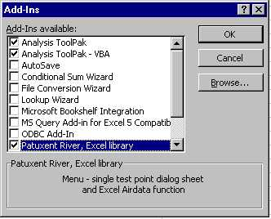
Assigning an Add-In
Now the Add-In menu item for Pax_Lib
“Patuxent River, Excel library”
will be checked.
For those using AirDat32A the menu item
“AirDat32A, Exel library”
will be checked.
Complete the assigning process by pressing the OK button.

Slide 16
De-Selecting an Add-In
1) Open Excel
2) Open a file (new, empty, or pre-existing)
3) At the Menu bar select
Tools / Add-Ins
4) Un-check the box labeled
AirDat32A, Excel library

Slide 17

Pax_Lib menu item
After the AirDat32A Add-In has been assigned, Excel will include a new menu item just to the left “Help”
Currently, the only item under AirData is “Airdata” (This unnecessary redundancy was in anticipation of other air data capabilities that have not materialized.)
Finding the Pax_lib menu item (now AirData) is a good way to verify that it has properly loaded on the machine.

Slide 18
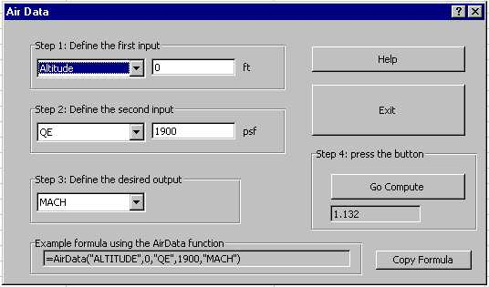
AirData menu / Air Data
The menu activated Air Data pop-up form is a good method to help you remember the syntax of the AirData function call.
User selectable input and output strings
Example Excel formula based on Steps 1 to 3.

Slide 19
Pax_Lib menu / Air Data
Probably should be labeled “Info” rather than Help
For the current version, the “Go Compute” button must be pressed to display a solution. Until the button is pressed the solution field is probably displaying stale data.
To obtain a copy of the AirData function formula into the clipboard (for pasting into an Excel cell), press this button.
Note: The equal sign does not copy and must be added in front of the formula within Excel.

Slide 20
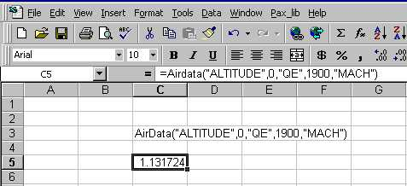
Pasting the formula into Excel
Excel refers to this area as the “Formula bar”.
The pasted formula (Cell C3) is a character string. To change it into a proper Excel formula, precede the formula with an equals sign.
Here the formula has been pasted into Cell C5 and the equals sign added (see the Formula bar).

Slide 21
Valid Input Strings
Altitude
  Altitude, Palt, Palt_Ft, Pressure Altitude
Mach
Air Speed
  KTAS, KTAS_Knts
  KEAS, KEAS_Knts
  KCAS, KCAS_Knts
Dynamic Pressure
  Qe, Qbar, Qe_psf, Dynamic Pressure
Impact Pressure
  Qc, Qc_psf, Impact Pressure
Not case sensitive !

Slide 22
Valid Input Pairs
Not all combinations of two inputs will produce a solution. So what are the valid input pairs?
The code will attempt to help you out with invalid entries (next slide)

Slide 23
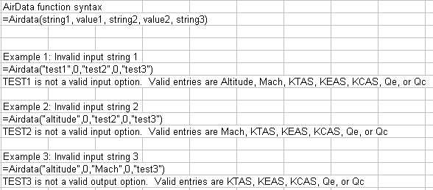
AirData function syntax help
Valid Input Pairs - cont.
The Airdata function will attempt to parse the arguments from left to right and give error messages as it fails in parsing.
The example has invalid strings in all three positions.
The valid entries listed are dependant on what has already been selected.
Note that in example 2, the first input has been selected as “altitude”. The error message for valid entries is aware that altitude has already been used.

Slide 24
Are we done yet?
We are done with normal operation
But, what do you do if
  You get a file with bad AirDat32A links (unresolved references)?
  Or, you’ve sent an AirDat32A Excel file to someone and they are having problems with unresolved references?
  Or, you wish to send someone a file and you know they don’t have access to AirDat32A?

Slide 25
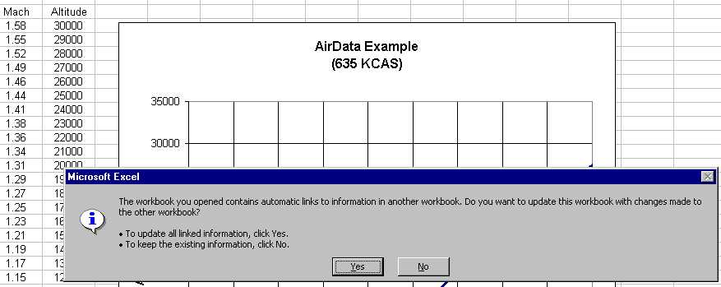
Correcting Unresolved Links
How do you know you have problems?
If you get this message, you have problems!
I typically answer, “NO” to this message.

Slide 26
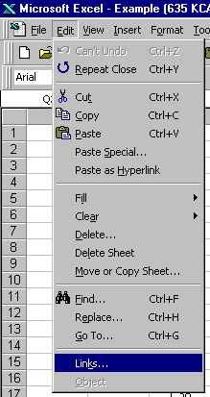
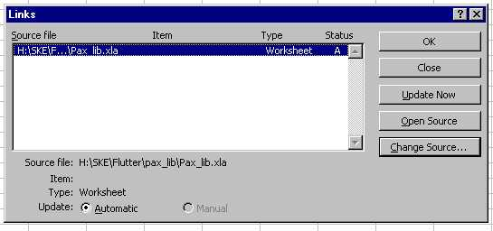
Correcting Unresolved Links
Use the menu item Edit / Links
To get the screen ...

Slide 27
Correcting Unresolved Links
Use the Change Source button from the previous screen and negotiate down the drive/directory path until you can find where your group has installed the AirDat32A.xla file.
Select the AirDat32A.xla file and then the OK button.

Slide 28
Exporting for non-AirDat32A users
Option 1 - Sever the Links (keeping it in Excel)
  Copy all cells with Airdata function calls and paste special, selecting the paste by value option
  Save the file under a new name
Option 2 - Distribute as a Picture (out of Excel)
  Select the chart or range of cells
  Hold down the shift key and use the Edit / Copy Picture option. This menu item is only available if the shift key is being held down.
  Paste the data into Word or PowerPoint

Slide 29
Closing Remarks
The only known error with early versions of the program are inaccuracies above 82,000 feet.
The current version has been modified to notify the user of this limitation and to not display any results.

